Slide 1
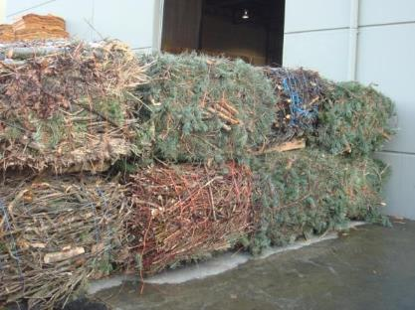




Baling & Roundwood Hauling for Fireline and WUI Fuels Reduction Woody Biomass:
Alternative to on-site Chipping
January 8, 2019
Brush and Forest Residuals Baler
Modular Roundwood Bunks
Jim Dooley
Mike Perry
Jason Perry
Notes:
Forest Concepts is an industrial cooperator in a US Department of Energy supported Biomass Research and Development Initiative project to reduce the cost of collecting forest logging residues for conversion to solid biofuels and biochar. The project, called Waste to Wisdom is led by Dr. Han-Sup Han at Humboldt State University.
Our role in the project is to evaluate the potential for baling branches and tops into large rectangular bales at logging sites scattered throughout forests. We are developing conceptual specifications, conducting limited field data collection using our engineering prototype woody biomass baler, and modeling the expected performance of conceptual baler types.
This presentation discusses how we used a stakeholder-driven process called Appreciative Design to establish bale sizes and top-level baler configurations.
This talk is a companion to an ASABE technical paper of the same title and a series of design reports prepared under the Waste to Wisdom project. The papers are available by contacting Forest Concepts.

Slide 2
Why Add Balers to Your Chipper Fleet?
Quiet – reduce noise in sensitive areas
Little/no dust where fugitive dust is an issue
Aggregation – baled wood biomass material is similar to other baled recyclables
  Easy to handle with forklifts & grapple loaders
  Stacks on small footprint
Second-mile/long haul transport
  Use tarped flatbed trucks or vans like hay and other recyclables
Grinding at destination to user specifications
Reduced biomass supply chain carbon footprint
  Lower fuel consumption compared to on-site chipping
  Higher long-haul transport payload with back-haul efficiency
  Grinding at point of use with efficient large grinders
  Potential for all-electric balers to support hand crews

Slide 3
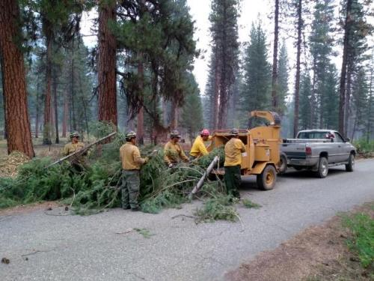
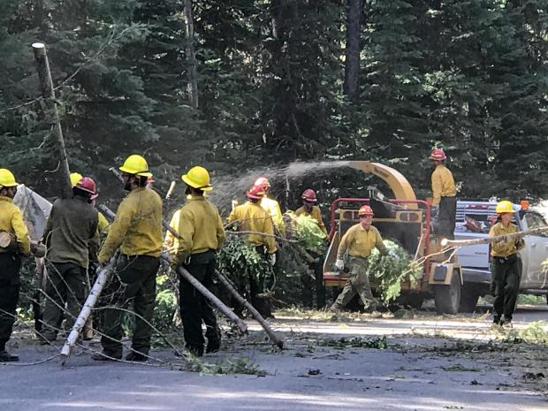
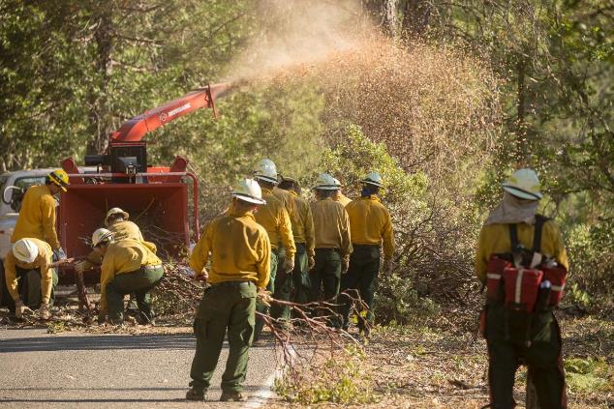
Problems with on-site chipping of fireline debris
Labor intensive
Ties up skilled crews
Precludes opportunity for beneficial use off-site

Slide 4
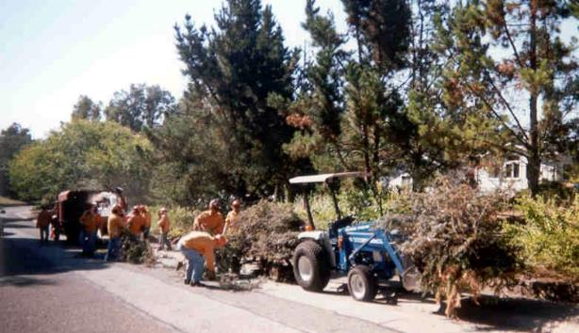
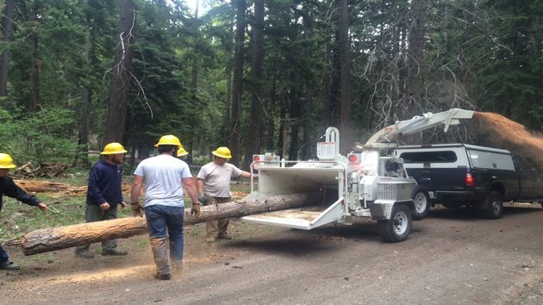
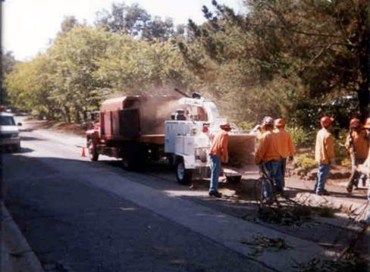
Problems with on-site chipping of wildfire protection and fuels reduction materials
Noise and dust
Ties up skilled crews
Precludes opportunity for beneficial use off-site

Slide 5
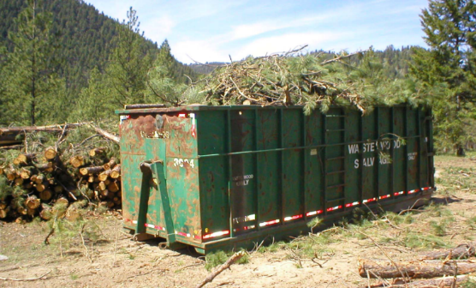
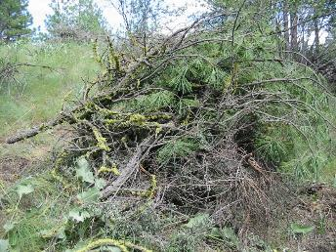
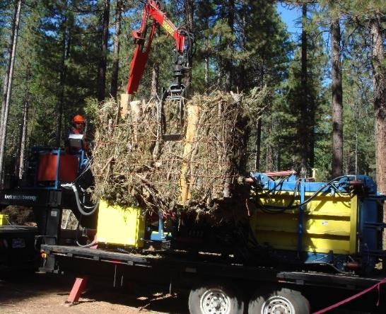
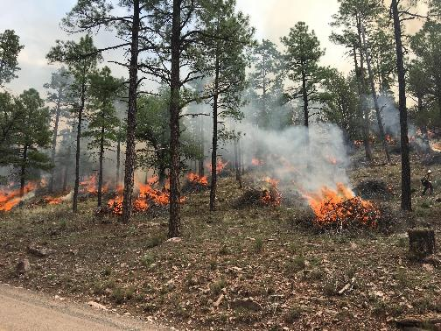
Alternatives to chipping
Haul in bulk bins & trucks
Lop and spread
Burn when able
Bale and haul like hay

Slide 6
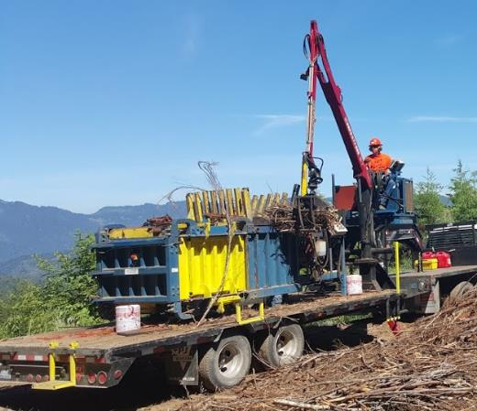
Woody biomass baler is a modular system
Module can be mounted on:
Hook-lift skid
Straight trailer
5th-wheel trailer
Log forwarder chassis
AWD truck chassis
Optional Equipment:
Slashing saw
Wire auto-tie
Small log/brush grapple
Hydraulic power unit
Tele-operation via RF
Chassis and running gear
Enables maximum use of common parts with your existing chipper fleet
Engine & hydraulic system
Axles & tires
Loaders & grapples

Slide 7
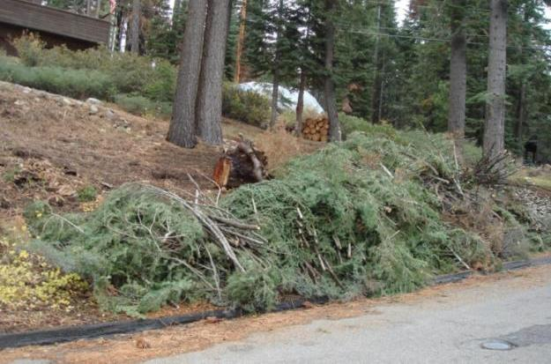
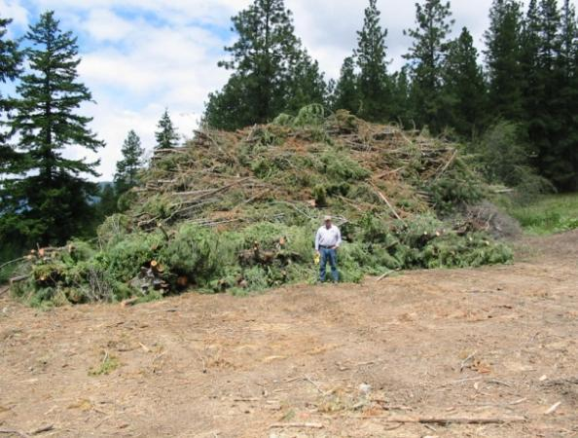
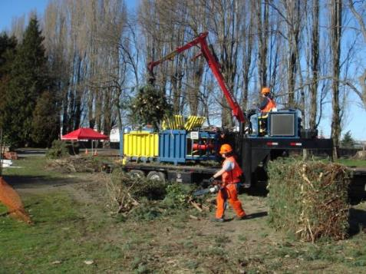
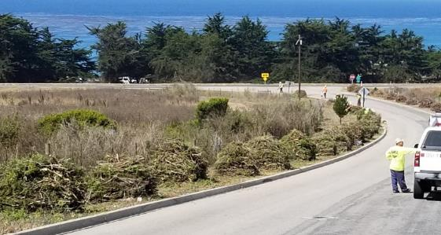
Why Bale? Minimize size reduction at the source (roadside, landing, or forest)
Lake Tahoe
Winthrop
This is a big WUI fuels reduction pile, BUT…it is on a play field in the middle of a residential area.
Onsite chipping or grinding are not options.
Cambria
Auburn

Slide 8
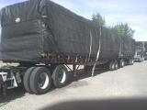
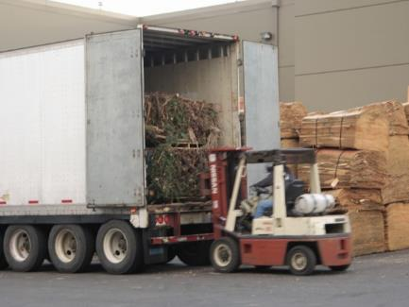
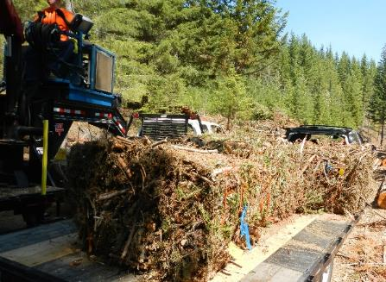

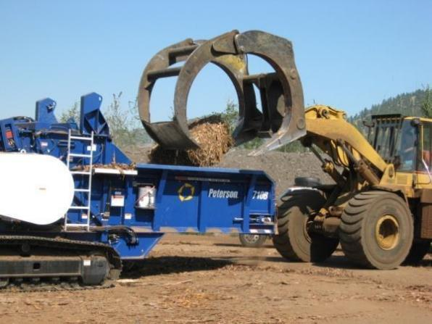
Why Bale? Enable cost-effective transportation, storage, and processing

Slide 9
Ten years in development
USDA NIFA SBIR – Small business innovation research program
USDA CAP NARA – Oregon State U.
DOE BETO BRDI – Humboldt State U.
USDA National Fire Plan – Deschutes NF
Yakama Nation Forestry – Baling alternative to pile burning
Deschutes County Forestry, OR – Fuels reduction thinning
City of Auburn, WA – Vegetation Mgmt. > Green Energy
Jones Tree Service, TX – Pipeline corridor Maint.
Asplundh Tree Service, WA – Powerline Maint.
Rainier Wood Recyclers, WA – Woody biomass fuels
Eco-Options Energy Co-op, BC – Woody bioenergy feedstocks

Slide 10
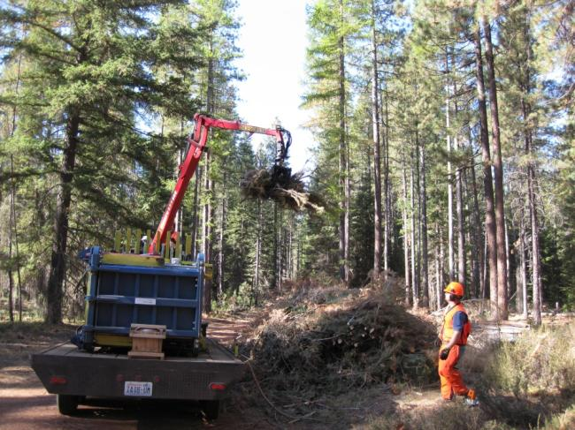
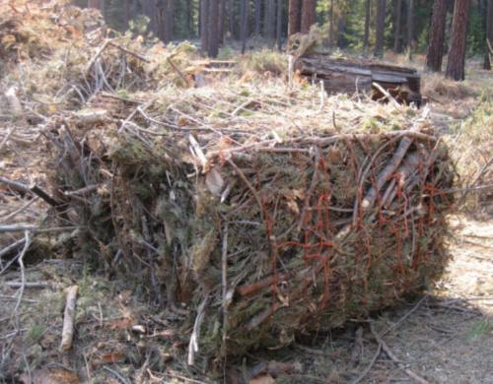
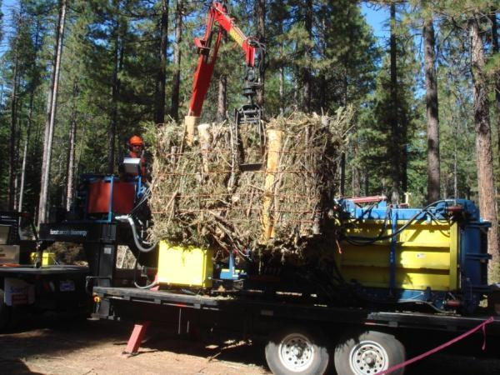
Woody Biomass Baler Test
Wildland Urban Interface – Deschutes County, OR
Deschutes NF field demo with
Forest Resources Association,
Friends of the Metolius
City of Bend,
USFS R6 Staff
Notes:
10

Slide 11
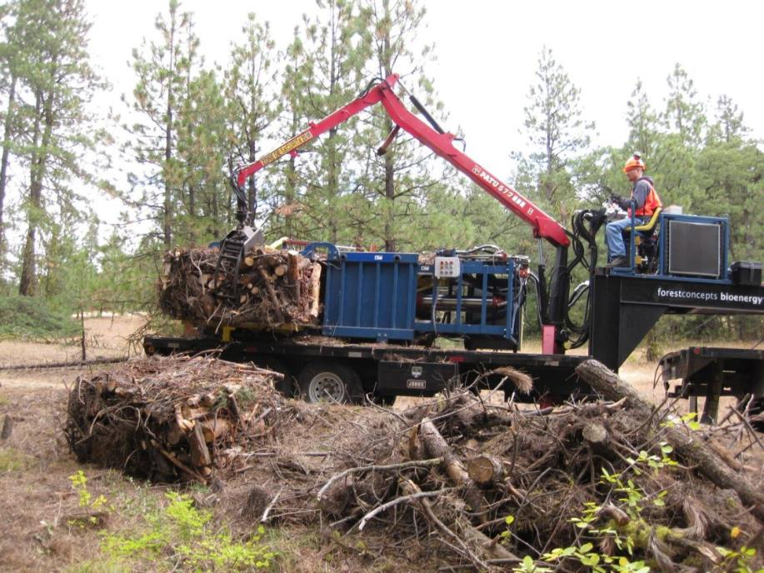
Yakama Forestry burn piles
After two years of waiting for
a burn window, these piles
needed to be hauled off-site.
Baling greatly reduced the cost.

Slide 12
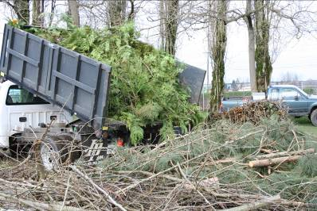
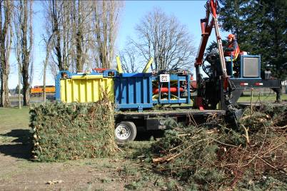
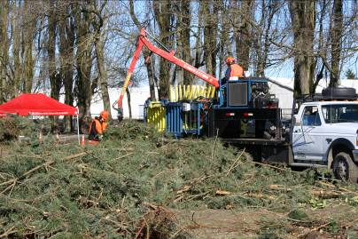

City of Auburn Parks and Roads

Slide 13
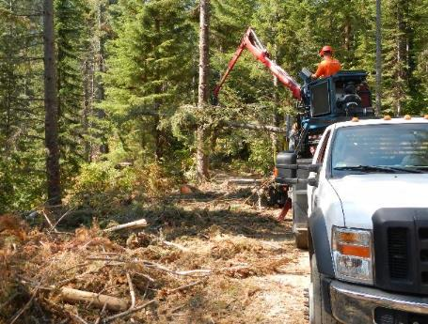
Forest biomass utility baler
Modular baler unit that can be mounted to:
  On-road or off-road trailer
  Log forwarder
  Tracked undercarriage
  Truck chassis or flatbed truck
  Hook-lift skid
Bale size and weight optimized for:
  Skid-steer loader handling
  Smaller horizontal grinders
Primary uses:
  Baling roadside windrows and supporting thinning crews
  Baling fireline and fuels reduction biomass
  Baling slash from keyhole and stranded landings
  Recovering dispersed slash
Baling roadside slash from forest thinnings
Snoqualmie National Forest (Aug 2015)
Notes:
One of the things we learned from stakeholders and prospective baler owners was they held many different opinions about the prime mover or running gear for forestry balers. Some were satisfied with our current on-road trailer concept. Others wanted a high flotation log-trailer type running gear. Quite a few stated that they would mount a baler onto an older model log forwarder or all-wheel drive truck chassis.
The diversity of wants suggests that our current baler design which is a bolt-on module is on the right track. The rendering on this slide is of a baler module mounted on a straight trailer having a pintle hitch and loader. This could be pulled by a 1-ton all-wheel drive truck, farm tractor, or lightweight forestry skidder.
The bale size for the utility baler was established to be easily lifted by commercially small-log loaders, skid-steer loaders with forks or clamping buckets, and the like. The bale dimensions were constrained to feed into the smallest models of Peterson horizontal grinders expected to be used by community-based centralized biomass conversion firms.
The operational niche for the forest utility baler includes the kind of site we are currently using on USFS land at Snoqualmie Pass and being thinned by Northwest Renewable Resources company. Their cable logging operation leaves a band or windrow of tops and branches along roads, with occasional small piles of delimber debris.

Slide 14
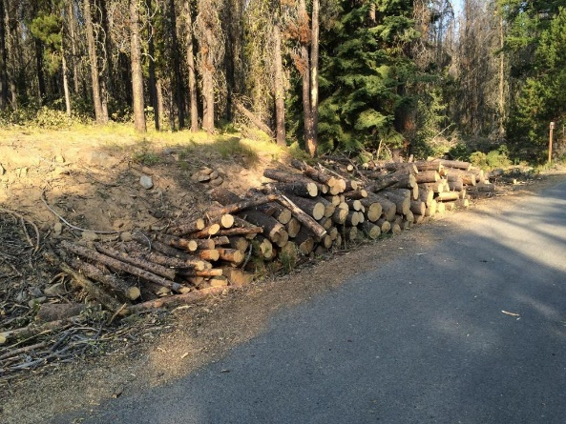
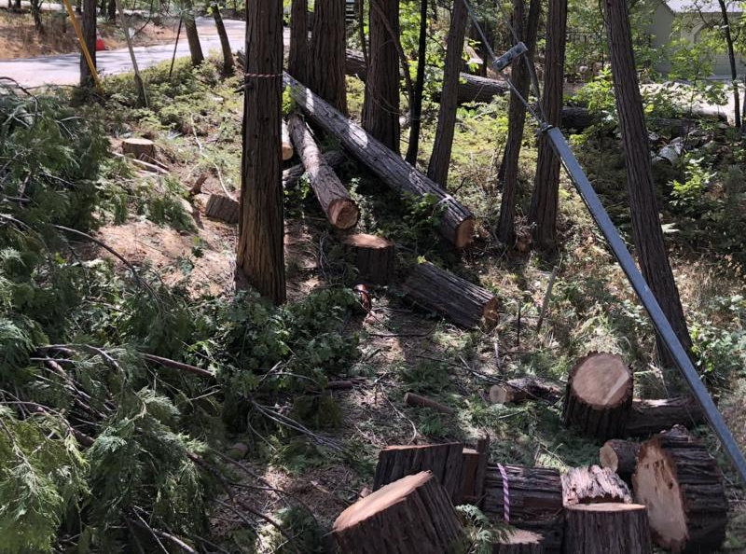
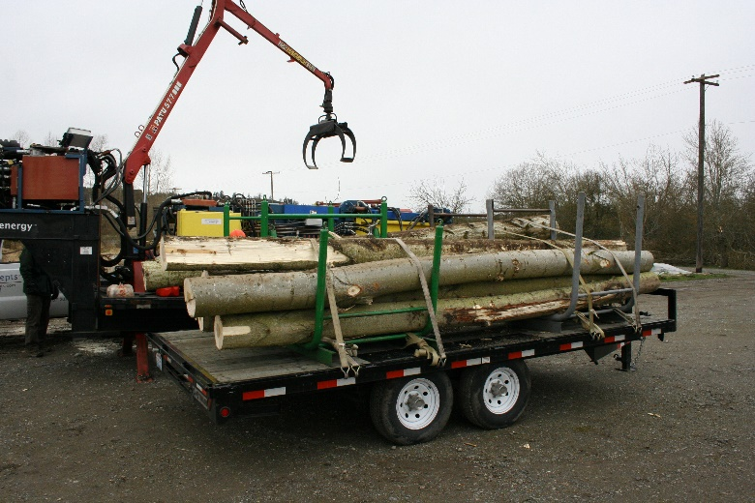
What about the roundwood?
Preserve length as much as practical
  Firewood-lengths are impractical to chip or grind
  4-5 ft. lengths enable uses + chipping or grinding
  9-18 ft. lengths enable production of lumber
Davis Harper Photo / PG&E site

Slide 15
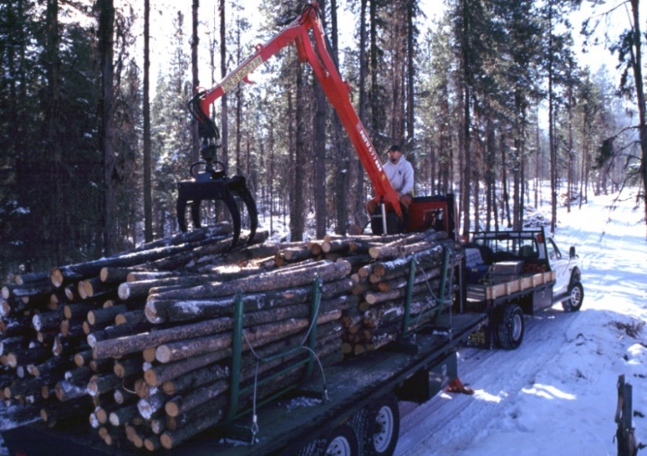
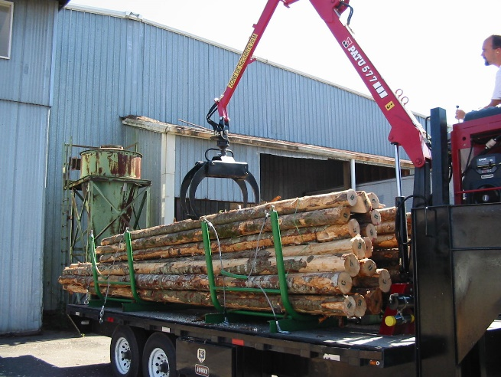
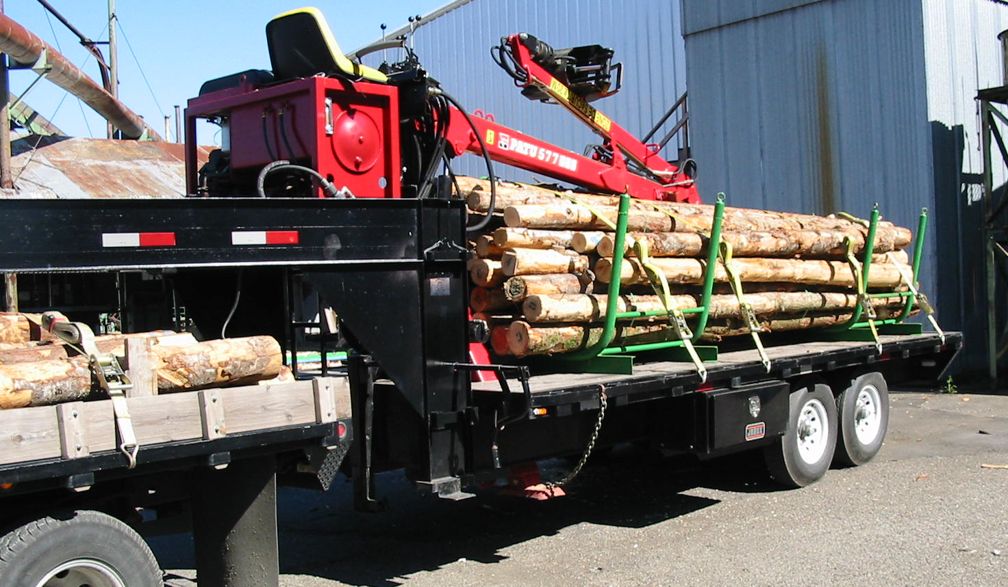
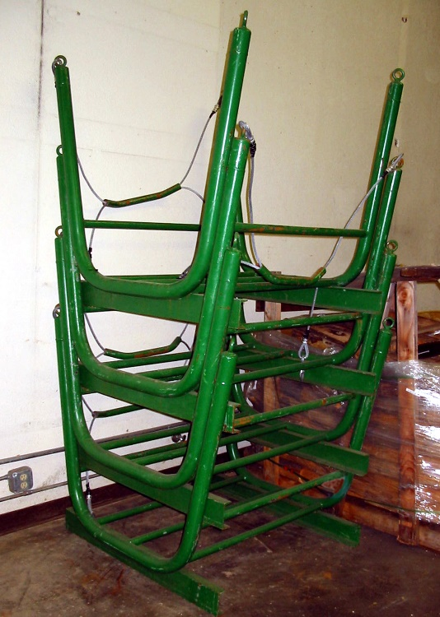
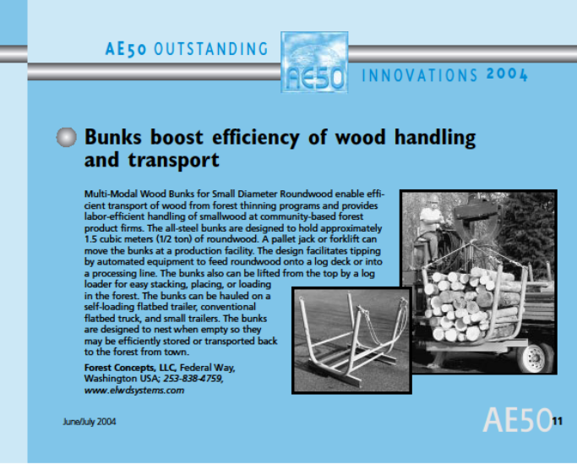
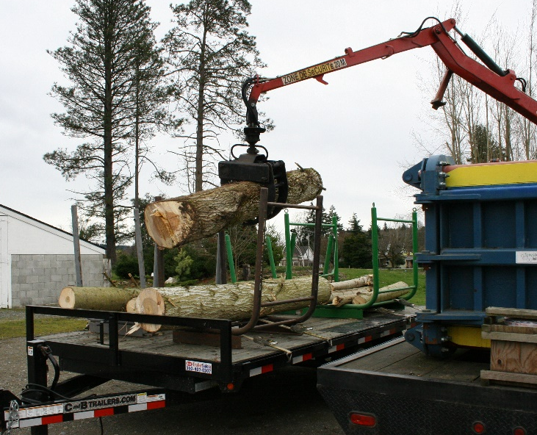
Forest Concepts Roundwood Bunks
Winner of 2004 AE50 Award for Innovation

Slide 16
Next Steps
Contact us to discuss your projects and needs
Arrange a time for a personal webinar
  More in-depth discussion in your context
  Videos of field trials and baler use
Arrange for live demonstration or site visit
Develop detailed specifications for a baler system optimized for your operations

Slide 17
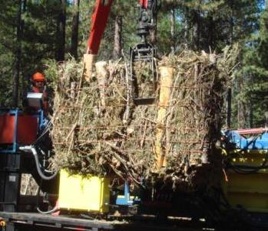


Thank You
Mike Perry
mperry@forestconcepts.com
Jim Dooley
jdooley@forestconcepts.com
www.forestconcepts.com
Baler development was supported in-part by the NIFA Small Business Innovation Research program of the U.S. Department of Agriculture, grants 2005-33610-15483 and 2006-33610-17595.
Testing and improvement project was supported by interagency Biomass Research and Development Initiative contract DE-EE0006297 managed by U.S. Department of Energy.
Roundwood handling development supported by the USDA Forest Service, National Fire Plan, and Mason Conservation District.
Field trials and demos were supported by USDA Forest Service and other cooperators/sponsors.
Contact:
Forest Concepts, LLC
3320 W. Valley Hwy. N., Ste. D110
Auburn, WA 98001
Ph: 253.333.9663
Notes:
The initial development of woody biomass baling was supported in-part by the CSREES Small Business Innovation Research program of the U.S. Department of Agriculture, grant number # 2006-33610-17595.
Current BRDI project is supported by interagency Biomass Research and Development Initiative contract DE-EE0006297 which is managed by US Department of Energy.

