Slide 1
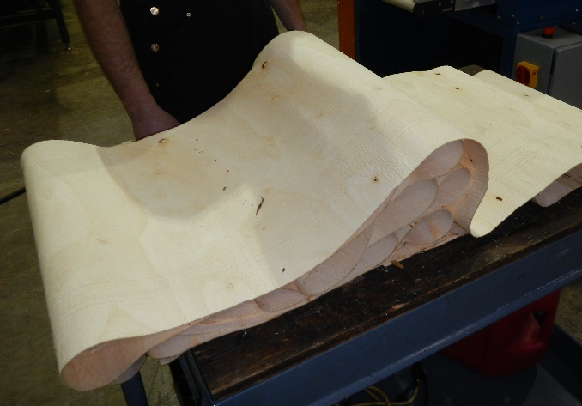
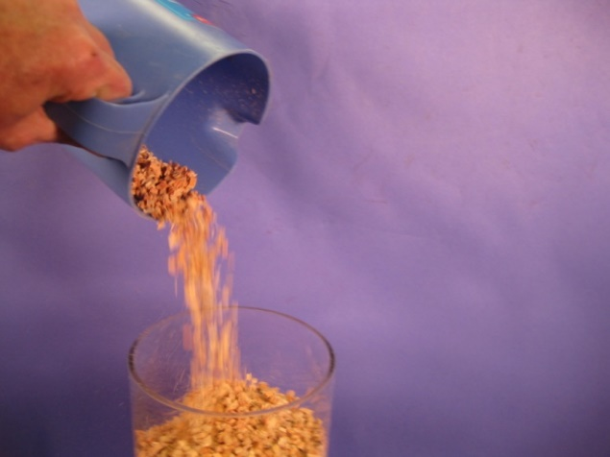
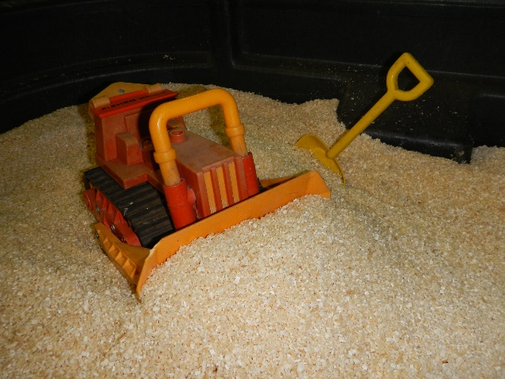

Crumbles® Technology
forestconcepts
Reactor-ready Feedstocks
The next generation of supply chain technologies
International Biomass Conference April 22,2015

Slide 2
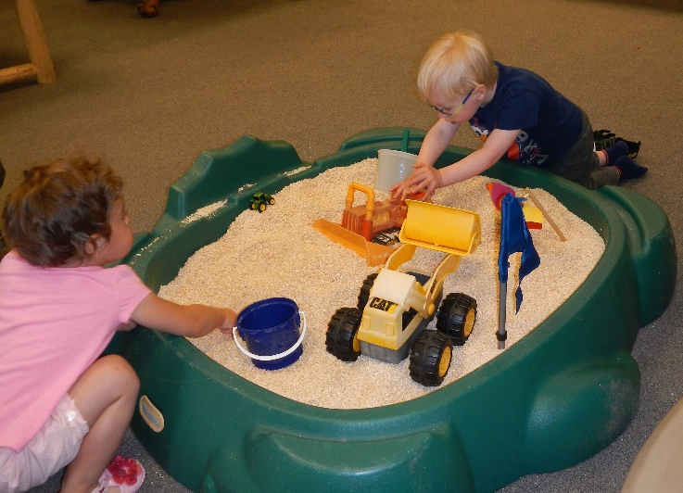
What is this Crumbles® Stuff?
Flows like grain
Crumble at Field Moisture
Don’t dry unless needed
Dry After milling when needed
OBTW – 1/3 the energy of hammer milling

Slide 3
Who is Forest Concepts?
Formed in 1998
Eight full-time regular employees
Based in Auburn, WA
A technology developer at the intersection of biology, engineering, and enterprise
  Bioenergy – Crumbles®, Beneficiation, and Baling
  Environmental Restoration – ELWd™ and WoodStraw®
  Distributed-scale enterprises
28 Issued US Patents in 4 technology families
  Biomass balers, Crumbles®, WoodStraw®, Beneficiation

Slide 4
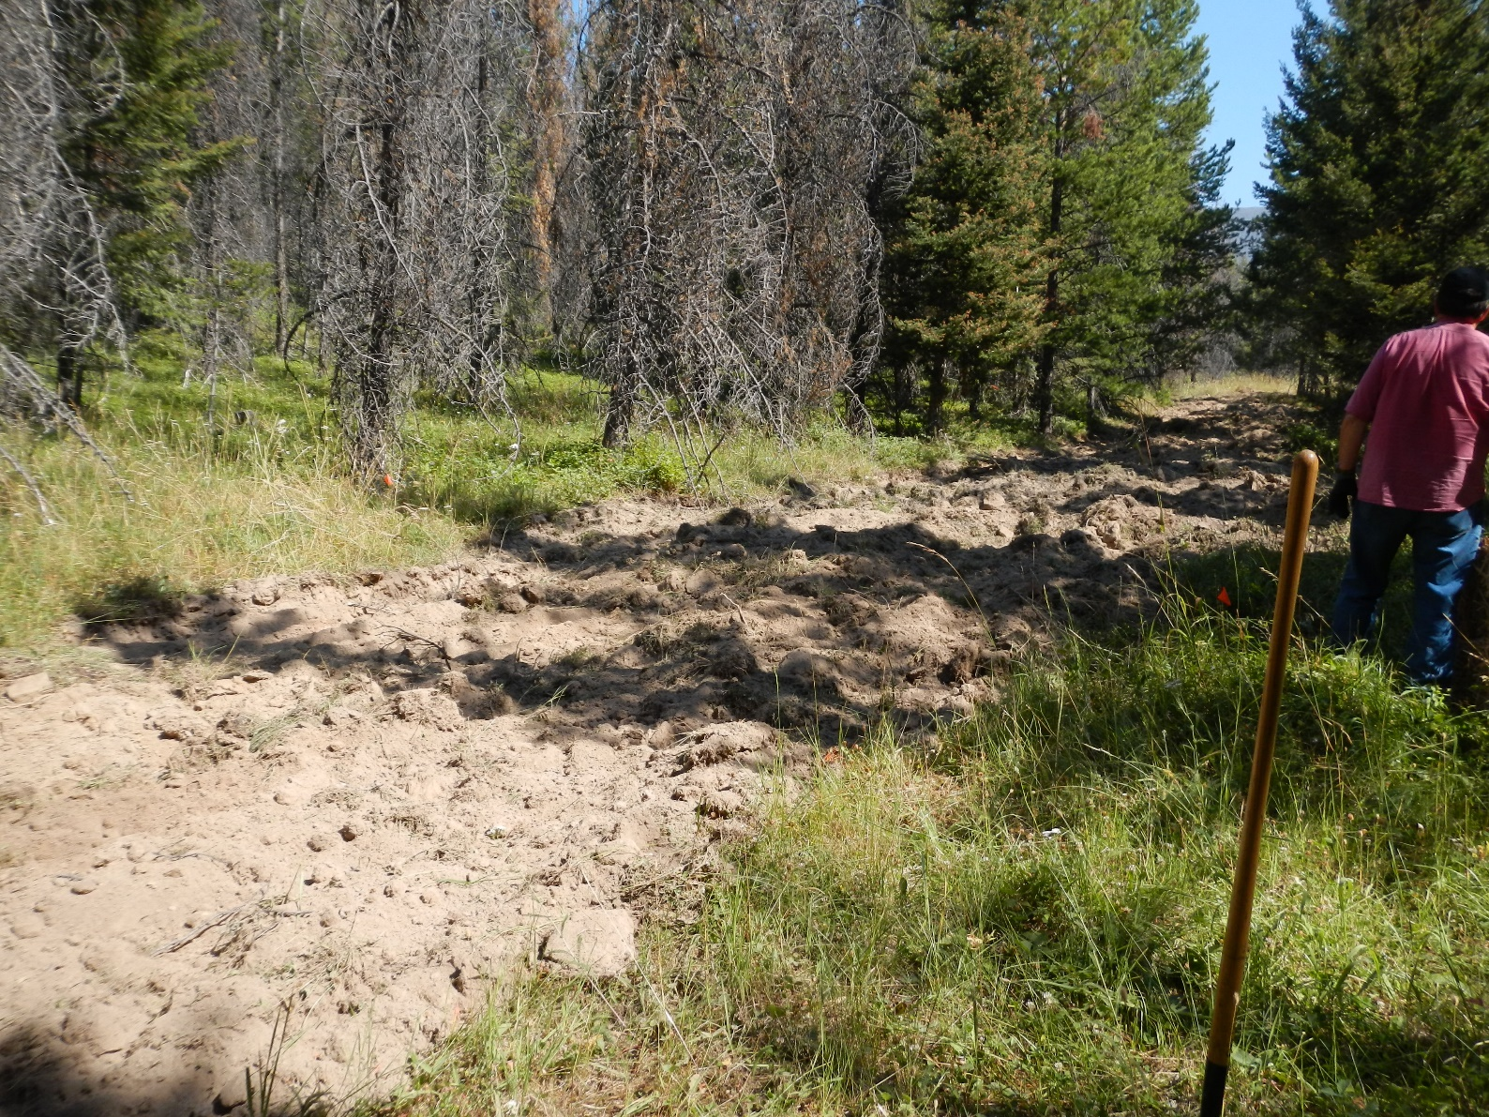
Erosion Control
How would Nature do it?

Slide 5
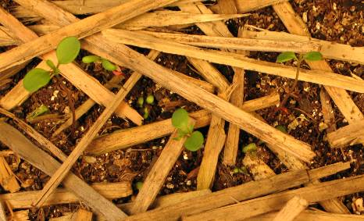
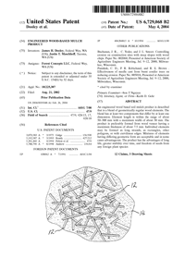
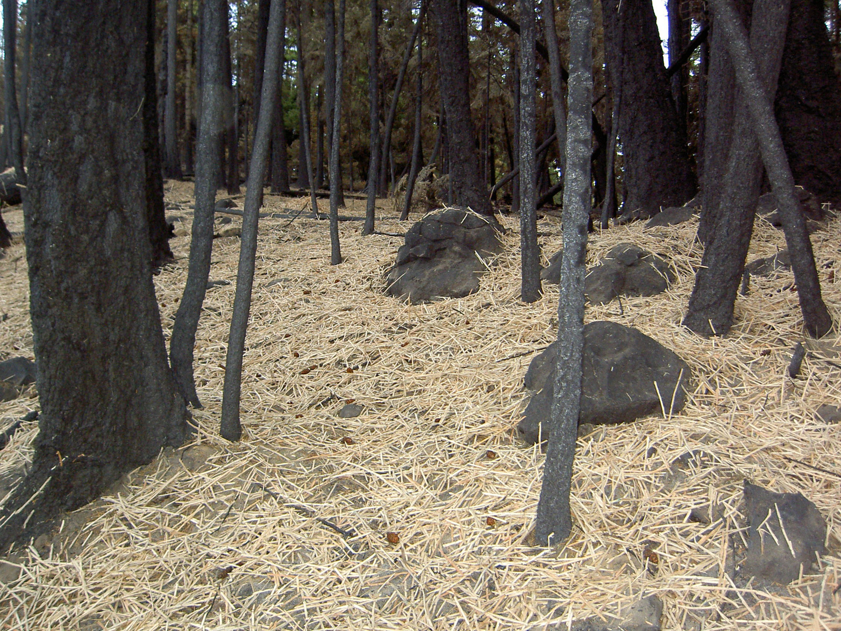
WoodStraw® 1.0

Slide 6
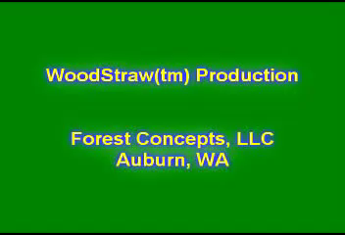
WoodStraw® 2.0

Slide 7
Cellulosic Biofuel Feedstocks
2008 Worldview
Corn stover and switchgrass are EASY!
Woody feedstocks are a pain in the butt!
  Too much energy to make
  Too much energy to dry
  Don’t flow for beans
  Chips are not the right format

Slide 8
Sound Science – Disciplined Engineering
How does length, width and thickness matter?
What dimensions need to be controlled?
How does conversion process matter?
What are system-optimal particle properties?
What is the theoretical minimum comminution energy to convert logs into ideal feedstock particles?
(about 75-100 MJ/Mg for 2mm GMD)

Slide 9
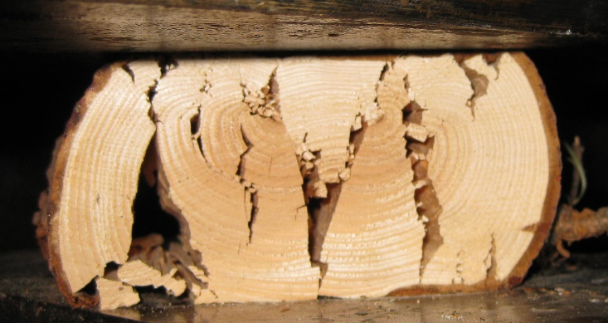
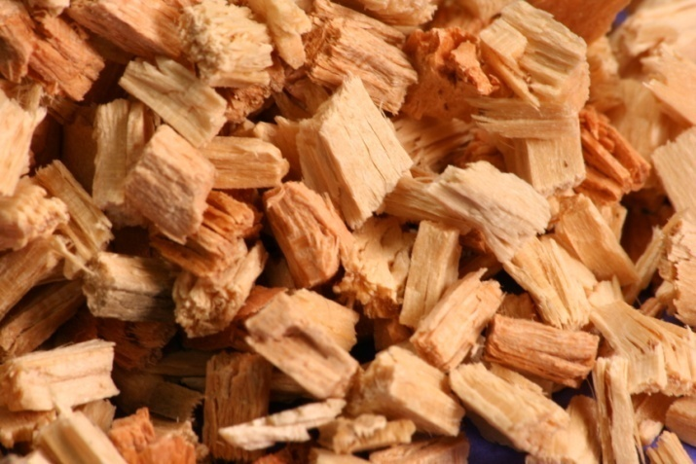
Wood Pathways
Crushing and Scrimming
Veneer and Crumbling
Chipping and Crumbling
Grinding and hammer-milling

Slide 10
Plants are Different!
Fiber Direction
Radial
Tangential
Longitudinal

Slide 11
Wood Pathways
Crushing and Scrimming
Veneer and Crumbling
Chipping and Crumbling
Grinding and hammer-milling

Slide 12
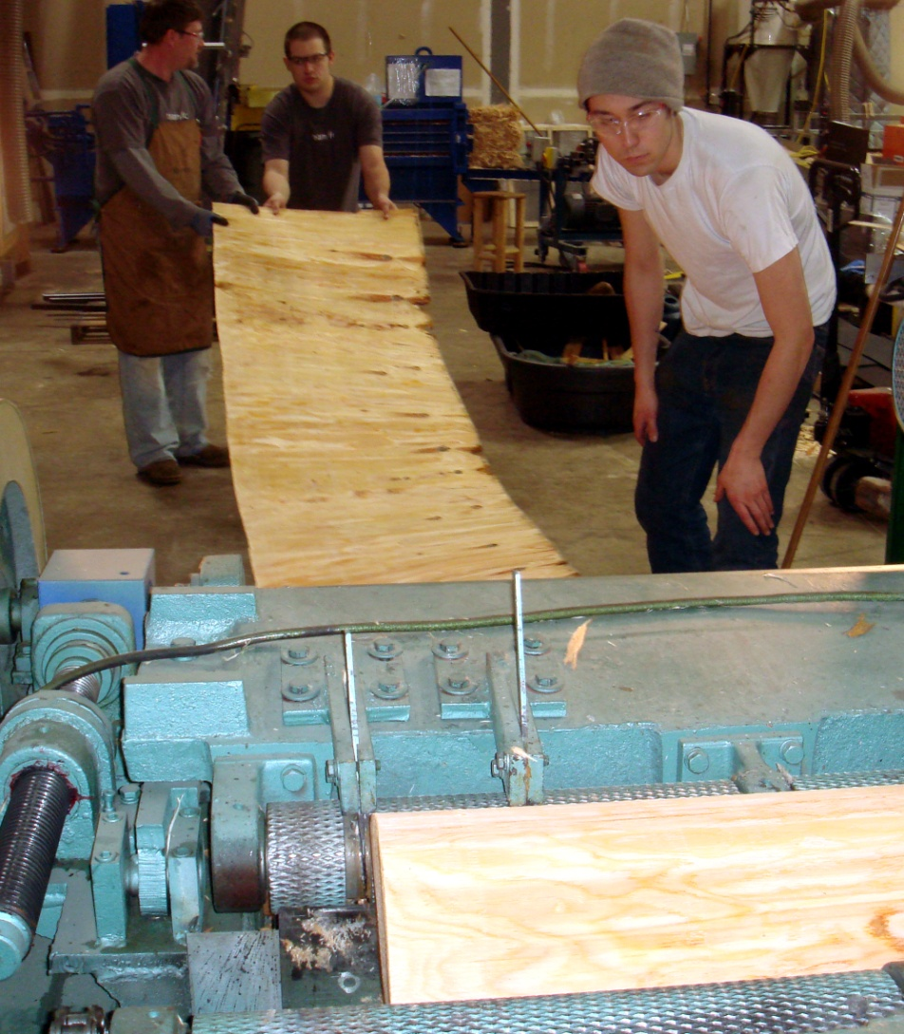
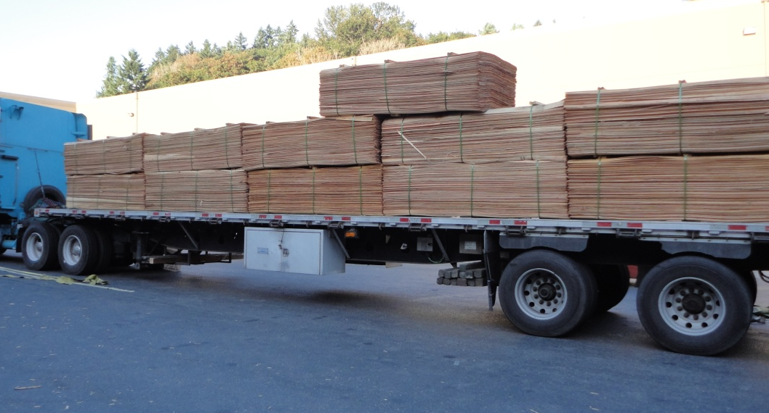
Crumbles® from Veneer
Industrial veneer from logs
High transport density
Controls thickness dimension
Enables separation of heartwood, sapwood and bark
Enables orientation with grain for next processing operation

Slide 13

Video
Crumbler M24 overview

Slide 14
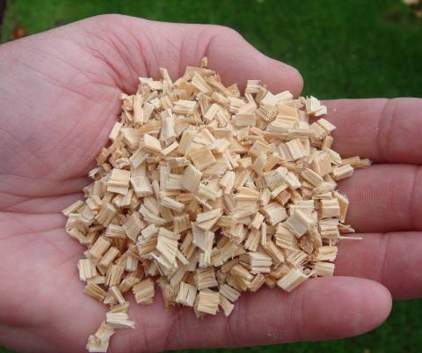
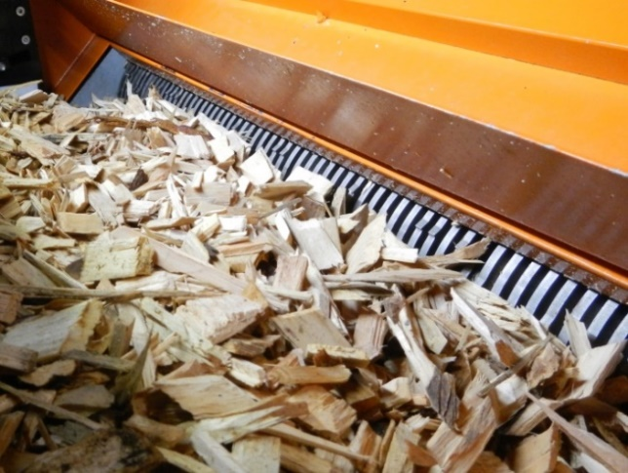
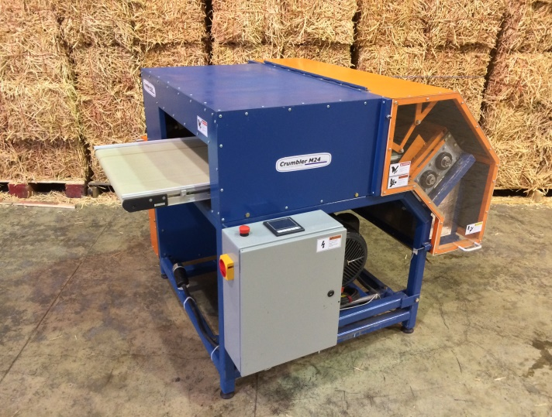
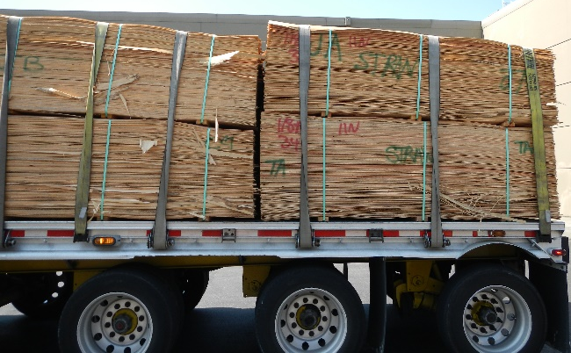
Crumbles® Particles
Precision particles
Physical properties are optimizable for specific conversion processes
  Length
  Thickness
  Moisture
  Uniformity of size
  Flowability
Two pathways
  From veneer
  From chips
Cascading processing of chip - particle size converges on cutter thickness
  Minimal production of fines

Slide 15
1.6mm Crumbles® From Chips
Size Distribution and Energy
Poplar chips Summary | Process | Output GMD | Moisture | Mass | Total E | Specific E
Sample ID | Size (mm) | (Xgm, mm) | (%wb) | (odkg) | (MJ/odMg) | (MJ/odMg)
2013.10.10.001.01 | Raw Chips | 11.82 | 55.0%
2013.10.10.001.01.A | 4.79 | 5.39 | 54.4% | 14.73 | 36.2 | 19.5
2013.10.10.001.01.A.A | 1.59 | 2.63 | 54.6% | 13.56 | 94.2 | 58.5
2013.10.10.001.01.A.A.A | 1.59 | 1.97 | 54.6% | 12.56 | 65.6 | 37.0
Sum of all passes |  |  |  |  | 196.0 | 115.0
Note: size shown to 1.6mm for comparison with hammermill
1.6mm

Slide 16
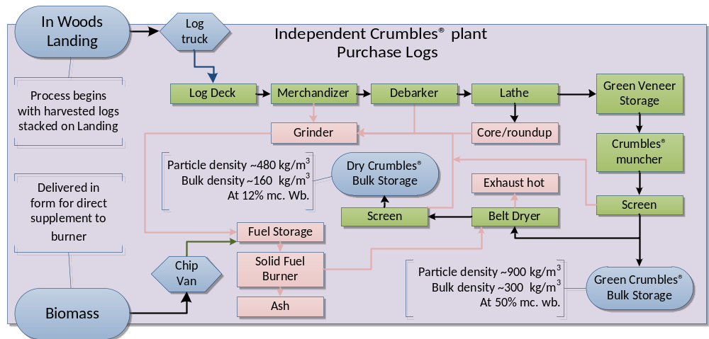
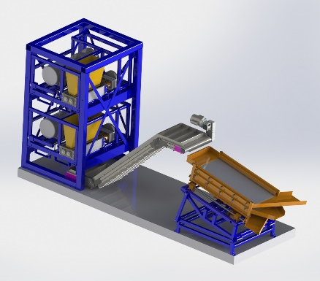
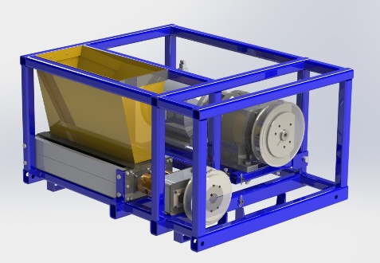
Precision Feedstocks®
Supply Chain Manufacturing and Cost Modeling
Capacity | Capital ($ millions)
odMg/day | Total | Equipment
100 | 3.8 | 2.1
400 | 15.5 | 9.5
1000 | 37.2 | 23.8

Slide 17
Crumbler vs Hammermill
Size Distribution and Energy
Particle Size Distribution
Comminution Energy (55% MC)

Slide 18
Crumbling Energy Cost from Chips
Comminution energy cost (Total Energy $/US Ton) for Optimized Crumbler® machine as a function of final size from poplar wood chips having an initial geometric mean particle size (Xgm) of 12 mm.

Slide 19
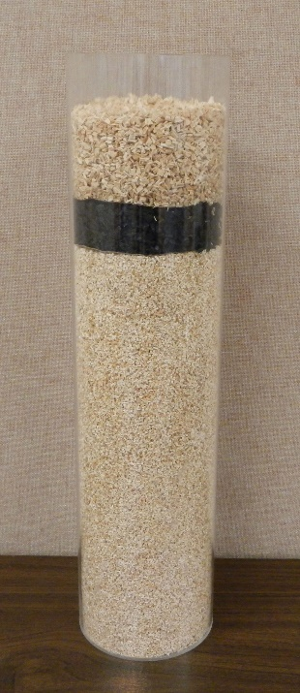
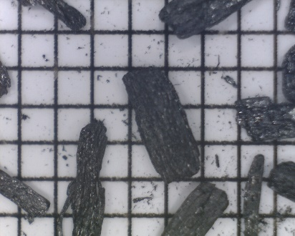
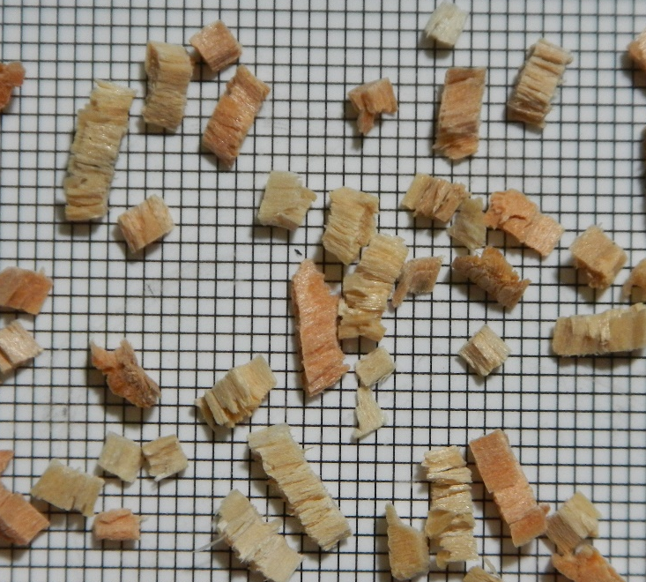
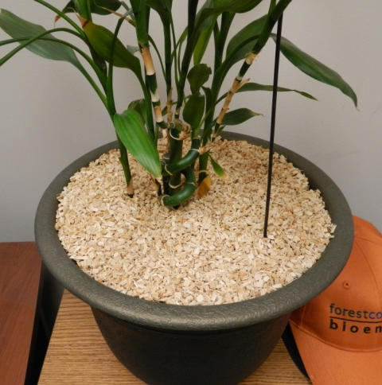
Bioproducts Opportunities

Slide 20
Relevance
Higher particle uniformity & flowability has positive downstream conversion benefits
Lower comminution energy costs reduce feedstock costs
Higher capital and maintenance costs than hammer-mills
Processing high-moisture biomass to small sizes reduces dryer capital and operating costs

Slide 21
Thank You
Mike Perry
mperry@forestconcepts.com
Jim Dooley
jdooley@forestconcepts.com
Development was supported in-part by the Small Business Innovation Research program of the U.S. Department of Agriculture contract 2013-33610-20827
Development was supported by US Department of Energy SBIR contracts DE-SC0002291 and DE-SC-0010122.
Forest Concepts, LLC
3320 W. Valley Hwy. N., STE D110
Auburn, WA 98001
253.333.9663
www.forestconcepts.com
Notes:
This project was supported in-part by the CSREES Small Business Innovation Research program of the U.S. Department of Agriculture, grant number # 2006-33610-17595.

